Slide 1


Project 0:
Cortisol & DHEA levels using SPIT
Joe Froelicher

Slide 2
Research Questions and Hypothesis
Question 1: Is there agreement between subject’s recordings of sampling times and the electronic monitoring caps?
Hypothesis 1: There is no disagreement between booklet sampling times and the electronic monitoring caps.
Question 2: Are subjects adhering accurately to the 30- and 600-minute recording times?
Hypothesis 2: Subjects are adhering to the 30- and 600- minute recording times.
Question 3: What is the change in Cortisol and DHEA over time?
There is a change in the rate of decay in hormone level from before the 30-minute time point to after.

Slide 3
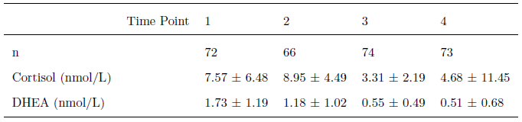
Data
N = 31 individuals * 4 time points * 3 days = 372
87 missing: N = 372 – 87 = 285
Variables:
booklet time, monitoring cap time, cortisol level, DHEA level

Slide 4
Analysis
Pearson’s correlation for differences between time recording techniques
Proportion of subjects adhering to within 7 and 15 minutes
Linear regression (random intercept) and piecewise linear regression (random intercept) for each of the two outcomes, Cortisol and DHEA

Slide 5
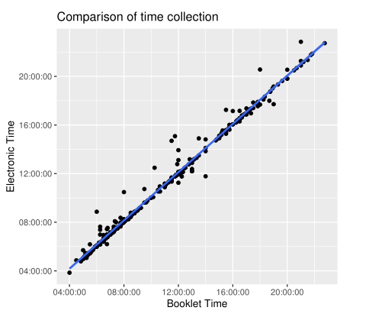
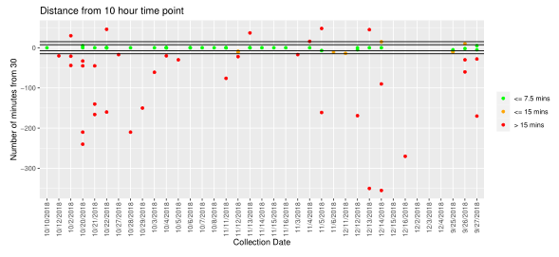
Results
Time recording methods are highly correlated (similar results)
Subjects adhere relatively well to the first time point of interest (~30 mins)
Adherence falls off for the second time point of interest (~600 mins)

Slide 6
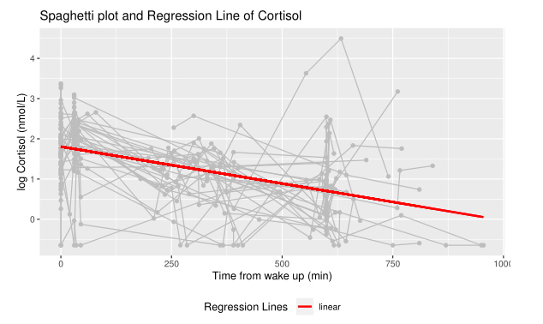
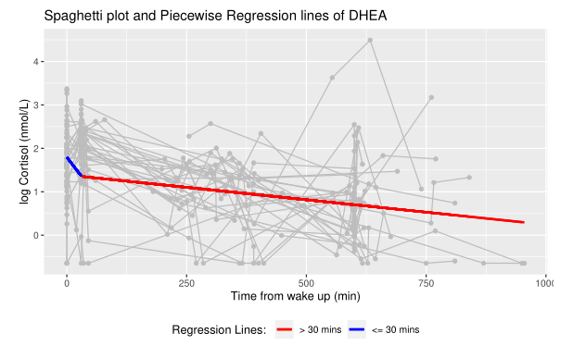
Results
Cortisol levels are not significantly different before and after 30 mins
DHEA levels are significantly different before and after 30 mins

Slide 7
Implications
DHEA has a non-linear trend over time – further analyses may be necessary
Cortisol and DHEA are levels that are continuous over time, should we be modeling them with continuous functions? (higher order models, interpolating between points)
Adherence was nothing to write home about, is there a better collection method?

Slide 8

THANK YOU

